Slide 1

About Nike
Web – App by
Shravanth Vidyacharan

Slide 2

Introduction
About Nike is a replica of original about Nike web site
This web Pages contains all the information about Nike
It contains Article page which has latest news about Nike
This is a multi-page responsive web-app with contains 4 pages
Index / Home page
About page
Contact page
News page

Slide 3
Problem Definition
Now a days almost all the web-apps are responsive and will have many pages.
The task was to design a multi-page responsive web-app.
The look and feel must not be outdated and also be user-friendly to users with good animation and design
Limit colours and fonts. Maintain a thematic colour scheme. For professional sites, try to limit the variety of fonts to three or fewer.
Web site must be optimized for mobile because Mobile is overtaking desktop and there will be many users using the cellphone then desktop or pc.

Slide 4
Methodology and Work done
I have used Waterfall Methodology to build this web-App
(Analysis, Design, Implementation, testing)
I have used Sublime text editor to build this website
I have also used chrome for visuals and also check for test with chrome Lighthouse extension
I have developed this site using Hyper text markup language (HTML), Cascading Style Sheet (CSS) and Java Script.
I have tested the website in mobile device too

Slide 5
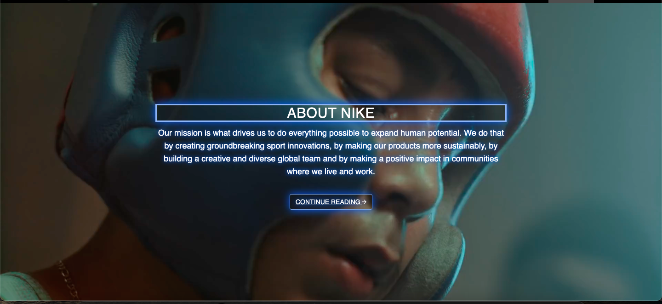
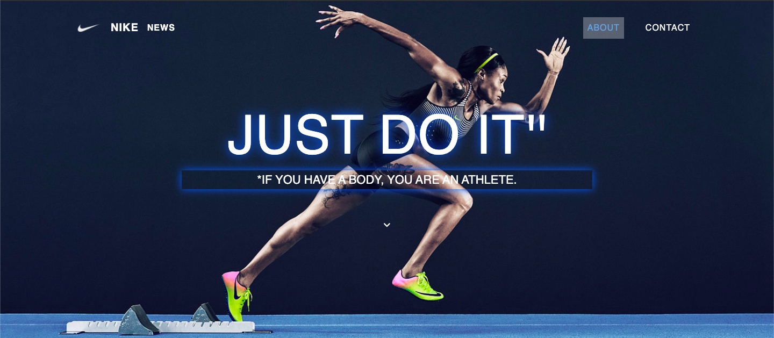

Results
Here are some of the outputs of the web page

Slide 6

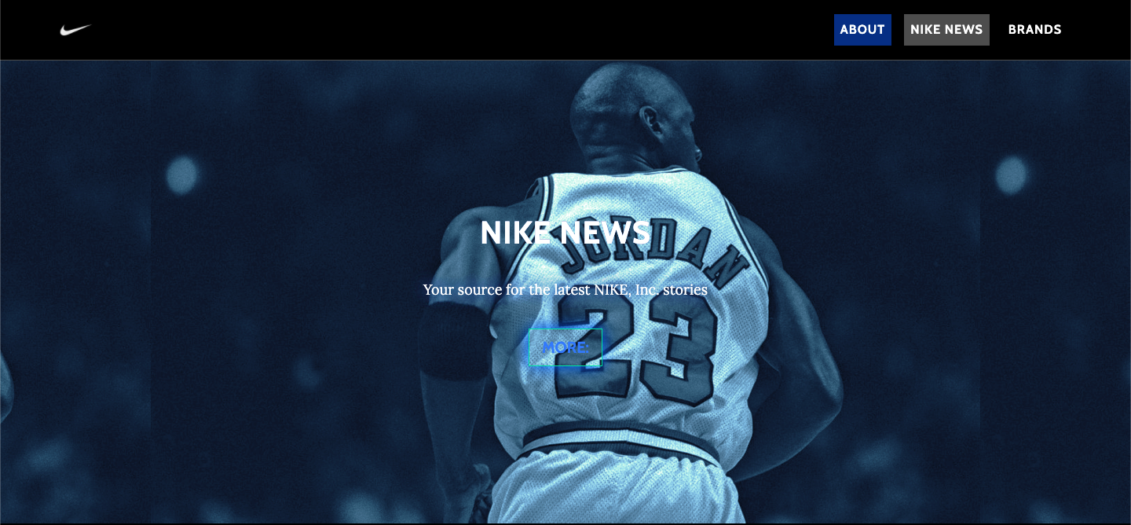
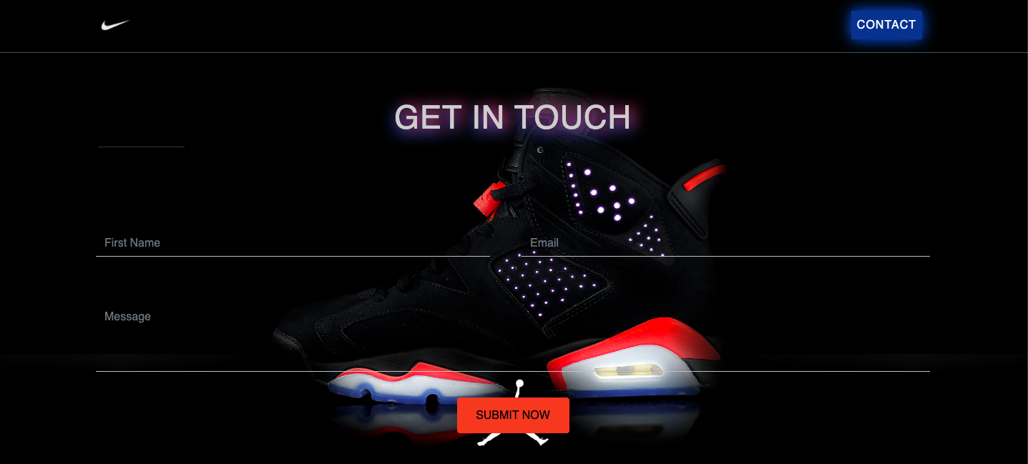

Slide 7
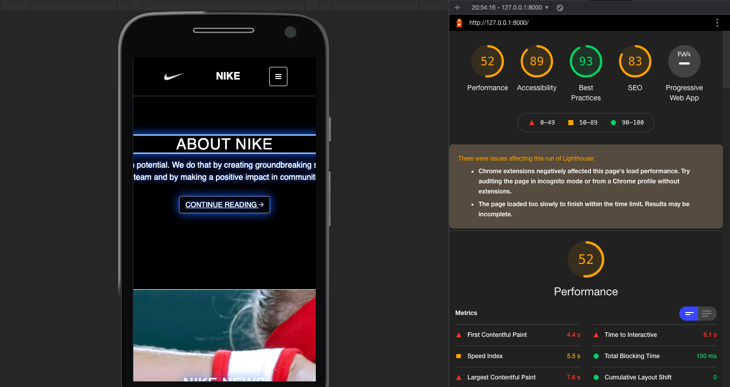
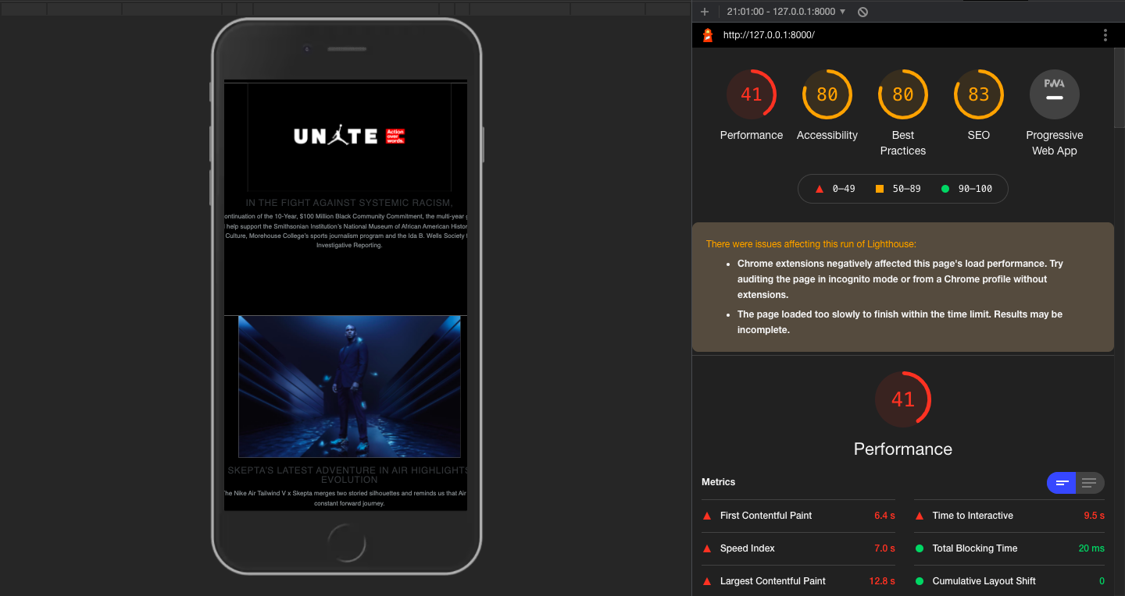
Test Results

Slide 8
Thank you
Shravanth Vidyacharan
shravanthshettigar10sep@gmail.com

